Slide 1
SIRS project - Insurance & Banking: BlingBank
Group 49
Gonçalo Silva 96925
Miguel Vale 99113
Renato Custódio 110948

Slide 2
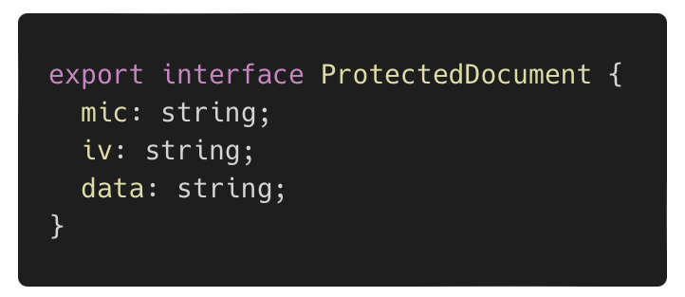
Secure Document
Integrity
Confidentiality

Slide 3
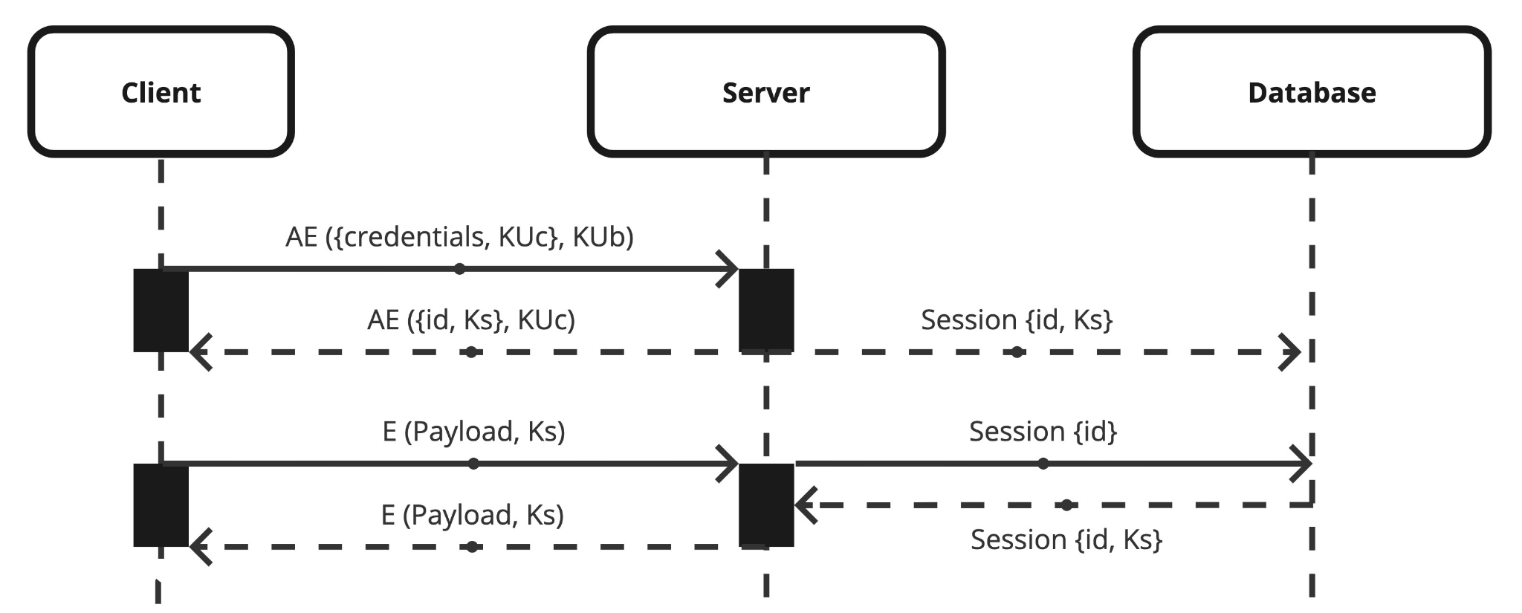
Secure channel establishment
HTTP Headers:
mic
session_id

Slide 4
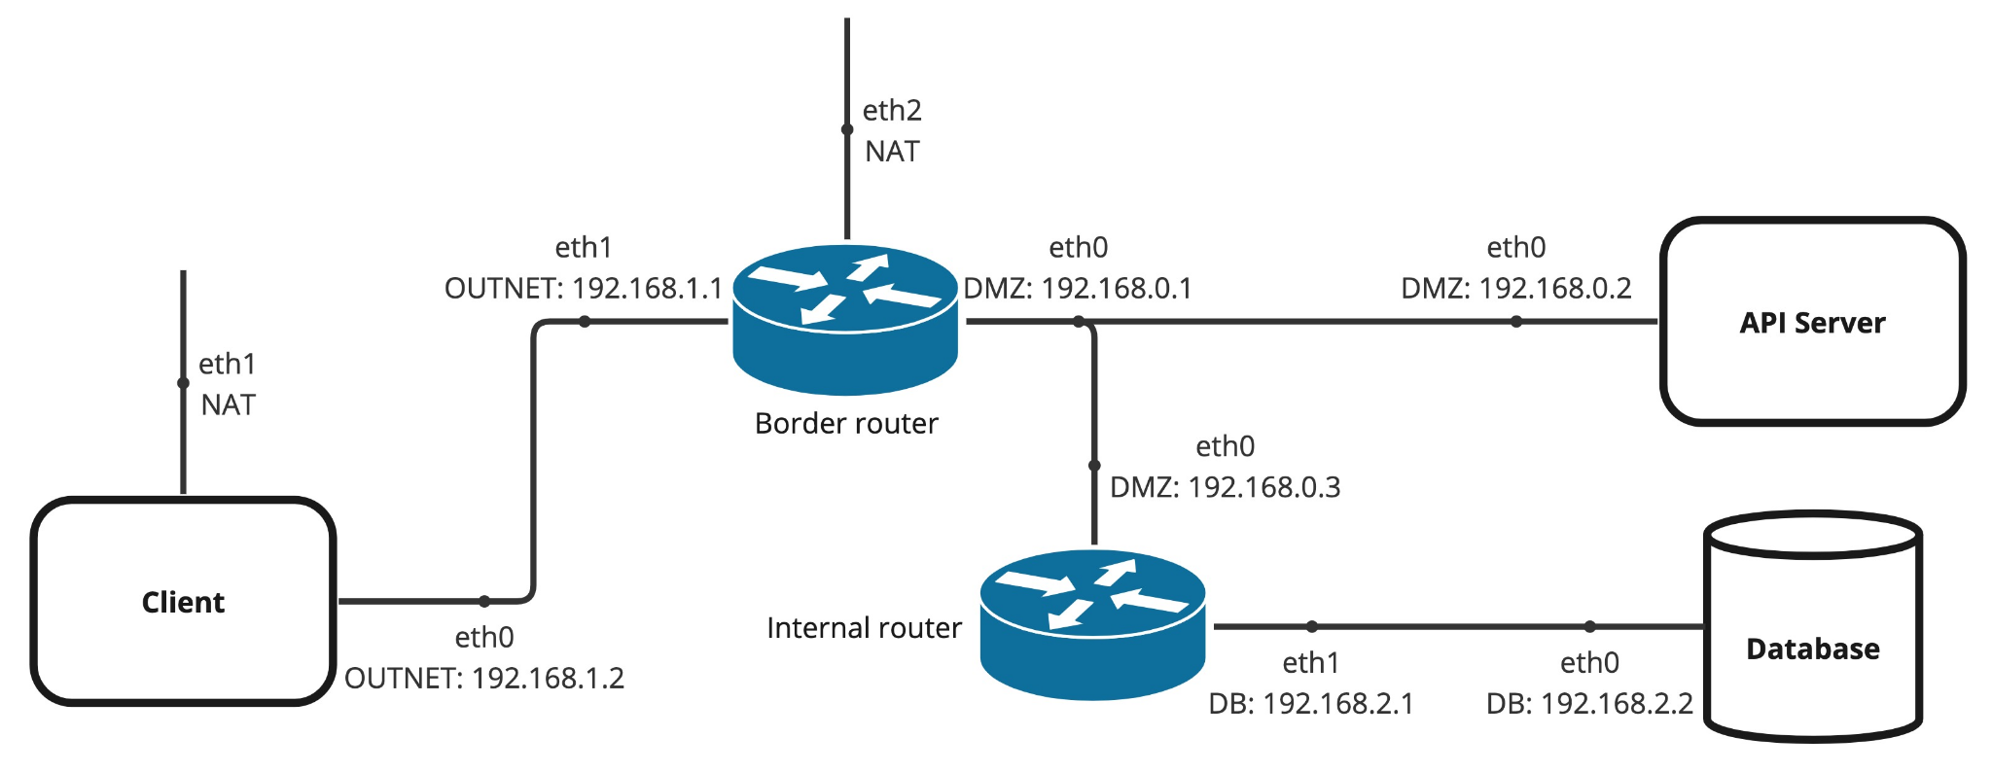
Infrastructure

Slide 5
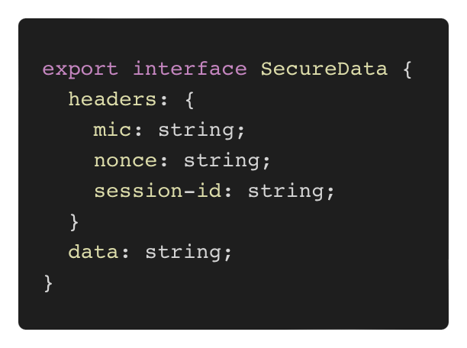
Security Challenge
HTTP packet format
Freshness
IV

Slide 6
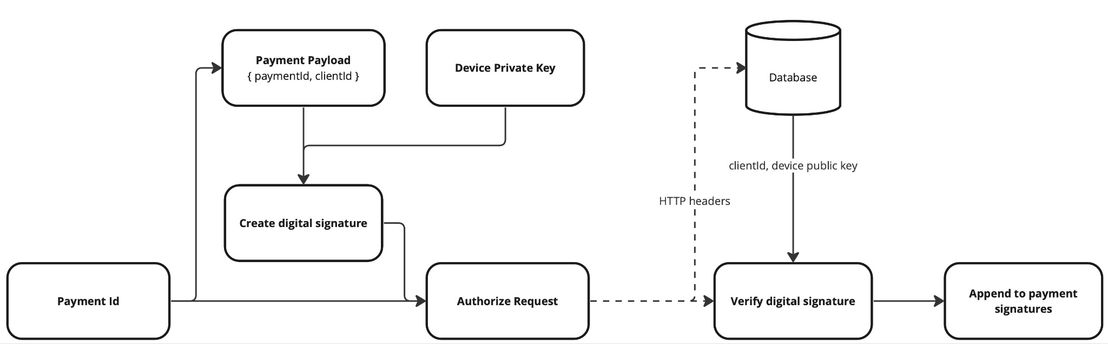
Security Challenge
Payments system

Slide 7
Demonstration

Slide 8
Q /A

